Slide 1

CUSTOMER CHURN ANALYSIS
SHAIMA Afreen
02-11-2022

Slide 2
OUTLINE
Executive Summary
Introduction
Methodology
Visualization
Insights
Conclusions

Slide 3
EXECUTIVE SUMMARY
Collected the dataset from Kaggle.com
https://www.kaggle.com/datasets/blastchar/telco-customer-churn
Imported the dataset in power BI.
Performed some transformations on the data.
Analyzed the data by using various visualization charts on power BI.

Slide 4
INTRODUCTION
Project background and context
The aim of the project is to analyze the customer churn for a company. Basically customer churn analysis is the process of measuring the rate at which customer leaves the product, site or service. A customer is very important for the growth of any business. So, analyzing the cause for churn is very important. Here, I am using Power BI to transform and analyze the data.
Problems you want to find answers
What is the cause for churn.
How can we stop the churning.

Slide 5
METHODOLOGY
Dataset was collected fro kaggle.com
Performed some transformation on data.
Added a new column, called ‘churn_flag’. The column was created from the column ‘churn’. In the column ‘churn’, we have values as ‘yes’ and ‘No’. We converted Yes to 1 and No to 0 in the newly added column.
The dataset have nine columns for each service having values as ‘Yes’ and ‘No’ which were replaced with 1 and 0 respectively.
Then for the above columns, changed the data types from Text to wholenumber.
Added a new column named ‘Total services’ from the above nine columns and applied the sum function.
Then performed visualizations to analyze the data.

Slide 6
VISUALIZATION
Analyzed data by using different visualizations present in the Power BI desktop application.
For example, analyzed total number of customers, total count of churn etc.
Calculated the churn percentage by making a new measure in power BI.
We used different charts like bar graph, line graph, cards, treemap etc. to visualize the data.
We analyzed the count of churn using different attributes like based on gender, partner, dependents, senior citizen, payment method, tenurity, contract type.
The link to the report is:
https://app.powerbi.com/groups/me/reports/be5df5b5-c86e-4e1a-9ff8-ee71c63215ff/ReportSection?bookmarkGuid=bafe09a6-e1c2-42cf-ac5b-c1da35e65b18&bookmarkUsage=1&ctid=2335c322-430f-4695-8746-529dd25ed072&fromEntryPoint=export

Slide 7
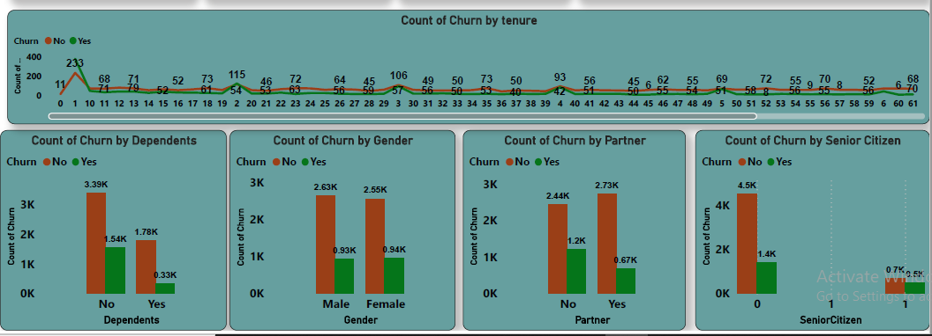
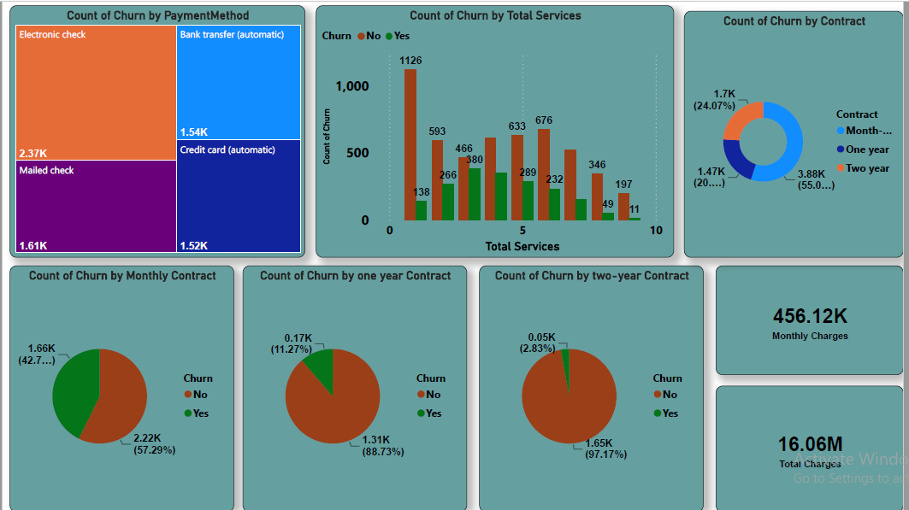
INSIGHTS

Slide 8
CONCLUSIONS
After analyzing the data, customers with payment method as electronic check have more churn rate. So, we need to focus more on this payment method.
Customers with paperless billing have more churn rate.
Customers with month-to-month contract have more churn rate compared to one year and two year plan.
Customers without partner have more churn rate.

Slide 9

THANK YOU

